Slide 1
ANOMALIES based INTRUSION DETECTION SYSTEM
Submitted To –
Dr. Kunwar Pal
Submitted By –
Himanshu Semwal (20103070)
Shivam Jaswal (20103133)

Slide 2

anomaly-based intrusion detection system
an intrusion detection system for detecting both network and computer intrusions and misuse by monitoring system activity and classifying it as either normal or anomalous

Slide 3
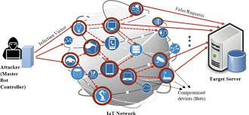
DOS Attacks on iot devices
Vulnerabilities Exploitation: IoT devices often lack robust security measures, making them susceptible to exploitation by malicious actors for launching DoS attacks.
Network Saturation: DoS attacks on IoT devices aim to overwhelm their limited processing power and network bandwidth, causing network congestion and service disruption.
Botnet Formation: Attackers frequently compromise numerous IoT devices to create botnets, amplifying the scale and impact of DoS attacks by coordinating synchronized assaults.
Impact on Critical Infrastructure: DoS attacks on IoT devices can disrupt critical services and infrastructure, including healthcare systems, smart grids, and transportation networks, posing significant risks to public safety and operations.

Slide 4
dataset

Slide 5
Data separation
In the data we have
Timestamp
Scr_port
Des_ip
Des_port
And so on, there are 67 columns which we are considering as the X-Axis component for the analysis
In the data we have
Class3
Where class3 represents weather it is an attack or normal which we are considering it as Y-axis component for the analysis

Slide 6

Data preprocessing
As the data set have varity of data sets as some columns has String type, some columns has char type Data types we are using Label encoding for the data preprocessing.

Slide 7
Feature selection
The dataset contains various components such as IP address, destination port, protocol, service, duration, source bytes, and others. These features are considered as they carry potential information about network behavior.
To identify the most relevant features for predicting attacks, consider:
- Domain Knowledge: Understanding of network protocols, common attack vectors, and typical behavior of normal traffic.
- Exploratory Data Analysis (EDA): Statistical analysis, correlation matrices, and data visualization to understand feature distributions and relationships.
- Feature Importance: Using preliminary models or statistical methods to identify features with the most impact on predictions.

Slide 8
Random forest

Slide 9
What is Random forest
Random Forest is an ensemble learning method that combines multiple individual models to improve overall performance and reduce overfitting. In the case of Random Forest, it combines multiple decision trees.
The basic building blocks of a Random Forest are decision trees, which are simple tree-structured models used to make predictions based on input features. Each tree in the forest is constructed using a random subset of the training data.
Random Forest uses bagging, a technique where each tree is trained on a random subset of the training data sampled with replacement (bootstrapping). This randomness helps improve the generalization and robustness of the forest.

Slide 10
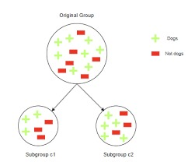
Random Forest – for dos attack detection
Model Selection:Chose the Random Forest algorithm for its robustness and ability to handle diverse datasets effectively.
Training and Testing Split:Used an 80/20 split for training and testing the model, ensuring a comprehensive evaluation with 80% of the data for training and 20% for testing.
High Accuracy:Achieved an impressive accuracy rate of 98%, indicating the model's high reliability in detecting DoS attacks.
Feature Utilization:Leveraged various attributes, including IP addresses, TCP data, and checksums, to train the model for accurate DoS attack detection.

Slide 11
Splitting data
1) Train-Test Split:
To train and test the model, split the dataset into training and testing subsets. A common split ratio is 80% for training and 20% for testing.
This ensures that the model learns from a substantial portion of the data while retaining a separate set for validation.
2) Stratified Splitting:
To ensure the split is representative of the entire dataset, consider using stratified sampling. This approach maintains the same proportion of attack and normal cases in both the training and testing sets.
This reduces the risk of bias and ensures the model is tested on a balanced dataset.

Slide 12
Training Random Forest
Training Process:
After splitting the dataset into training and testing subsets, I used the training set to build the Random Forest model.
The training involved constructing multiple decision trees, each using a random subset of the training data (bagging) and a random selection of features for each split.
Handling Class Imbalances:
Given potential class imbalances (e.g., more normal signals than attacking ones), I adjusted the model to account for this. This included setting the class weights to be inversely proportional to the class frequency, helping to prevent bias towards the majority class.

Slide 13
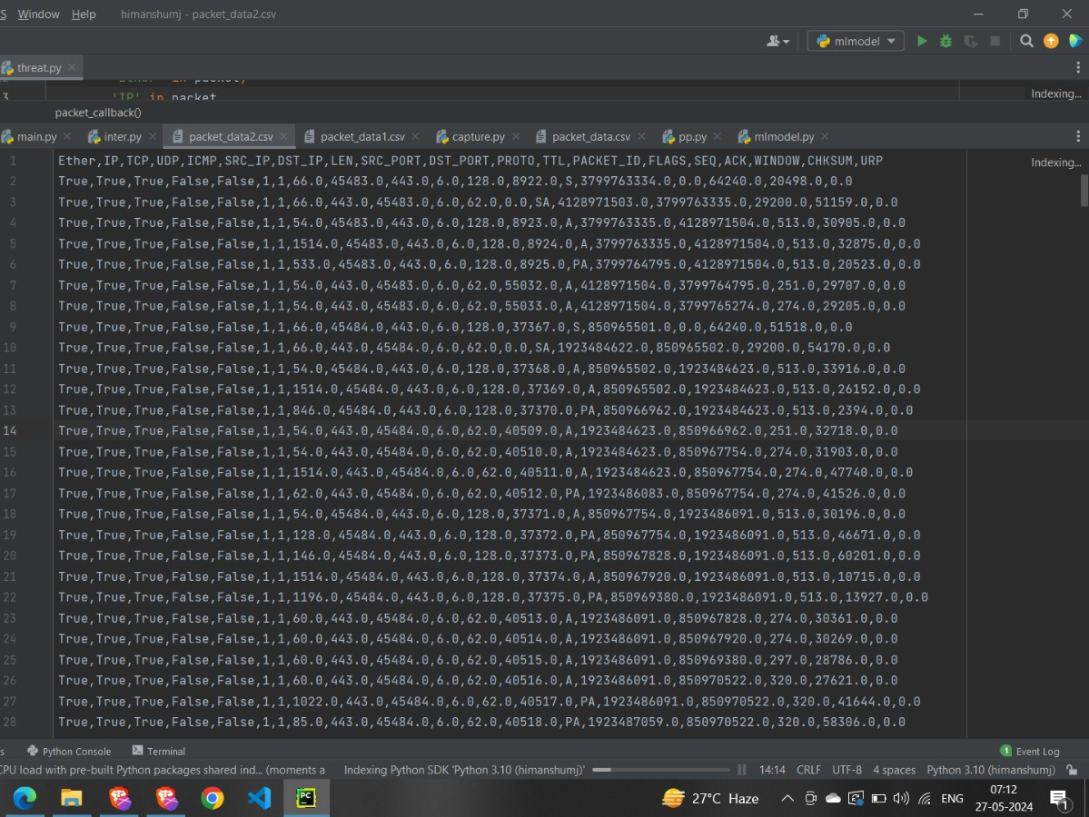
Scrapy – for real time data collection
Continuous Data Fetching:Scrapy enables continuous and automated scraping of real-time data from network interfaces, such as the WiFi eth0 port.
Custom Spiders for Specific Data:Custom spiders can be designed to extract specific network attributes like IP addresses, TCP data, and checksums in real-time.
Integration with Data Pipelines:Scrapy can be integrated with data pipelines to process, clean, and store the collected data in databases or files for further analysis.
Scalability and Efficiency:Scrapy is highly efficient and scalable, capable of handling large volumes of data and running multiple spiders concurrently for comprehensive real-time data collection.

Slide 14
Model Evalution
Model Predictions:
The trained Random Forest model was used to predict the labels (attacking or normal) for each instance in the test dataset.
These predictions were then compared against the actual labels to evaluate the model’s performance.
Overall Performance:
The Random Forest model achieved a high accuracy rate, indicating that it generally performs well in identifying both normal and attacking signals.
The F1-score was also high, suggesting a good balance between precision and recall. This indicates that the model can detect attacks while minimizing false positives.

Slide 15


Slide 16
Conclusion
Effective Real-Time Monitoring: The integration of Scrapy for real-time data collection and a Random Forest model for DoS attack detection demonstrates the efficacy of leveraging advanced technologies in network security.
High Accuracy and Reliability: Achieving a 98% accuracy rate in detecting DoS attacks highlights the robustness and reliability of the implemented solution, providing confidence in its ability to mitigate potential threats effectively.
Practical Application Potential: The successful implementation of the project showcases the practical application of machine learning algorithms and web scraping techniques in enhancing cybersecurity measures, particularly in IoT environments.
Future Directions: As cyber threats continue to evolve, ongoing research and development efforts are crucial for further refining and expanding the capabilities of the system, ensuring its adaptability to emerging security challenges.

Slide 17
Thank you
SHIVAM JASWAL (20103133)
HIMANSHU SEMWAL (20103070)

